Slide 1
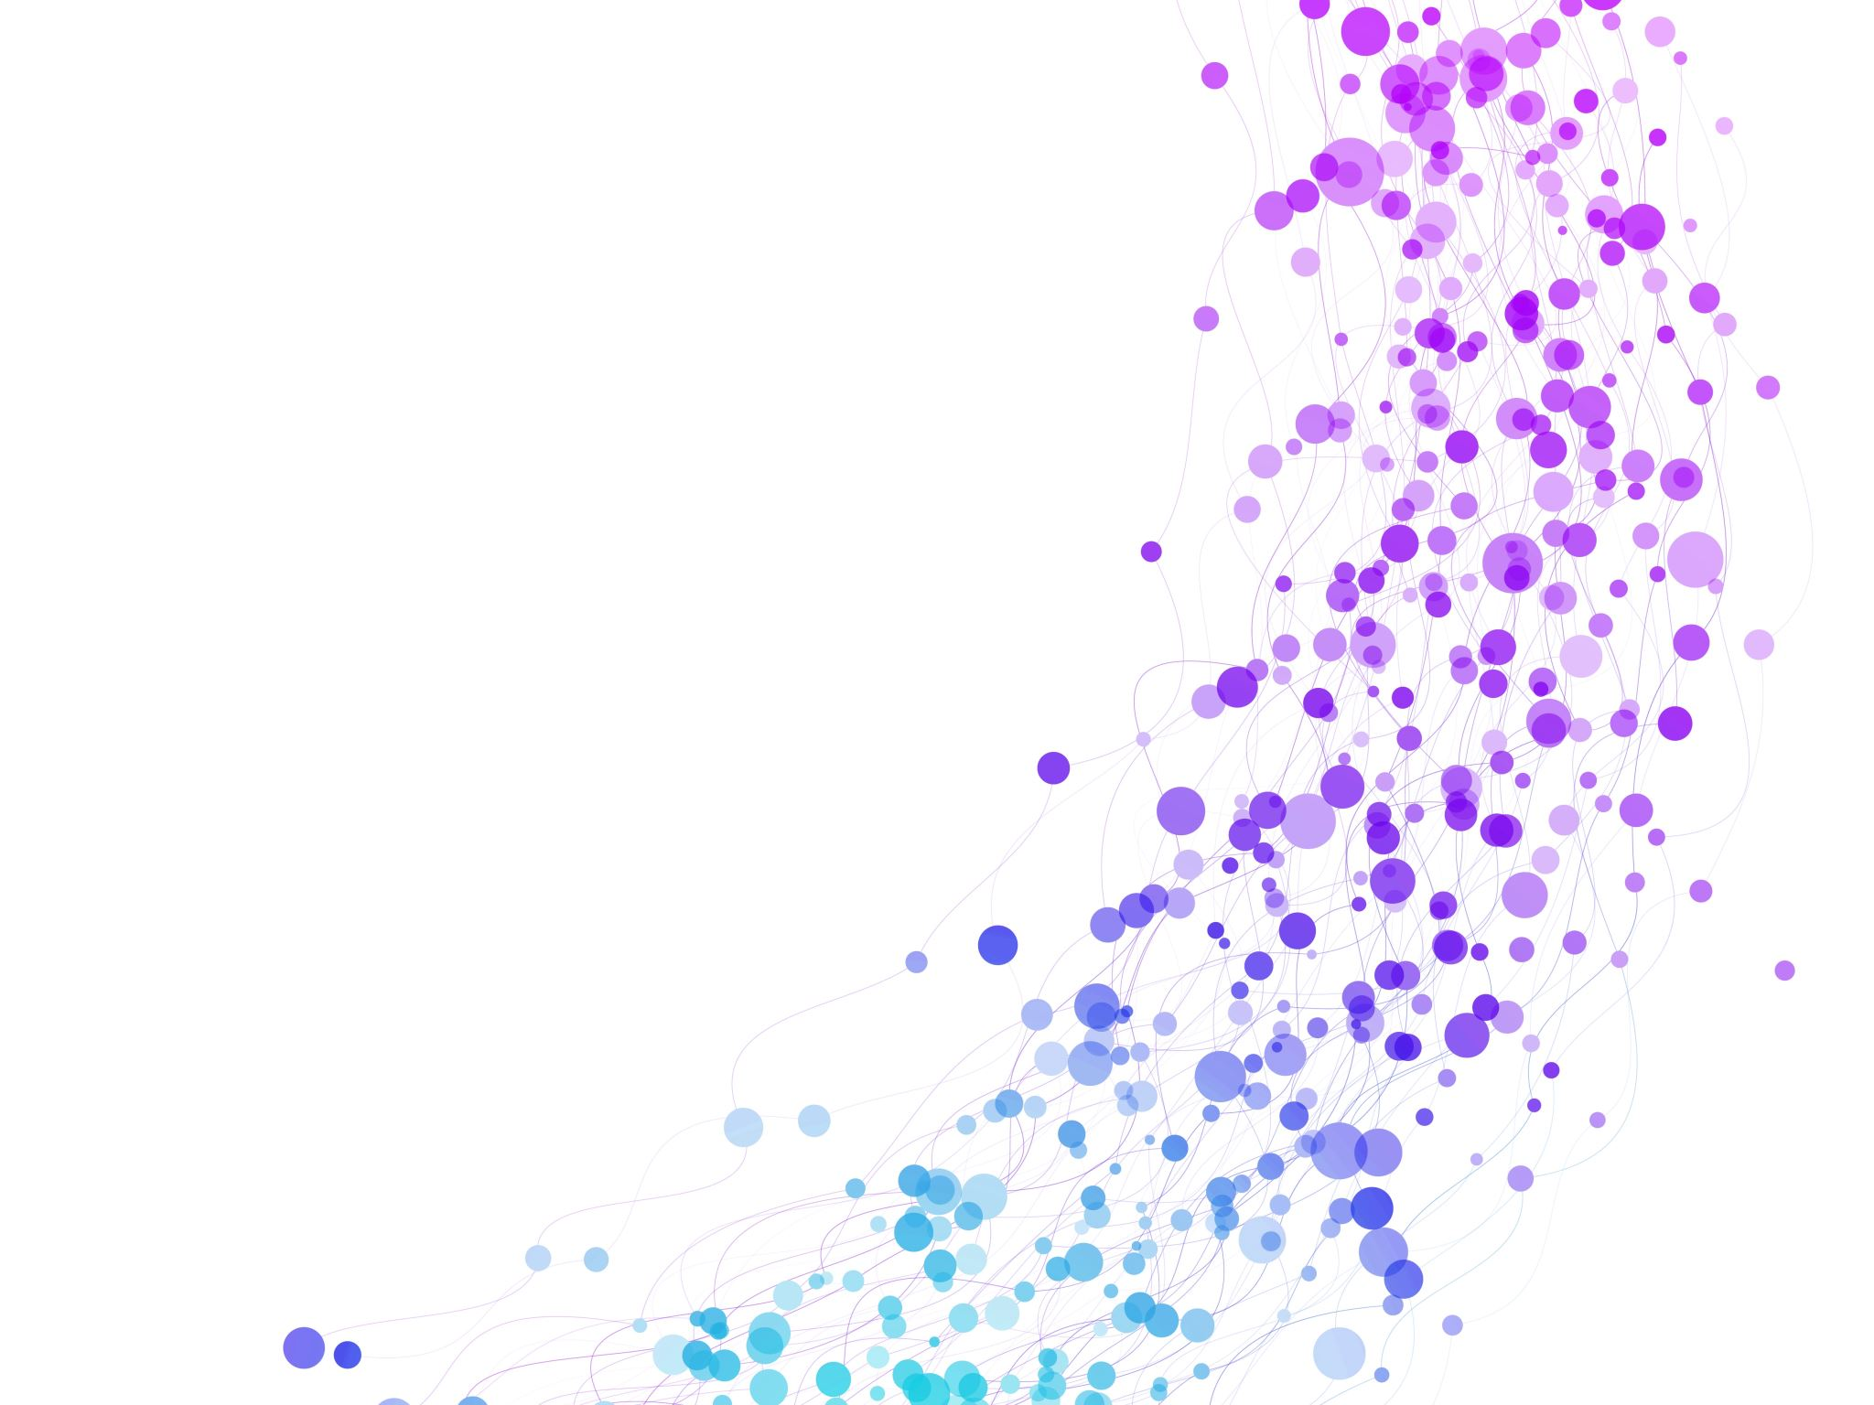


Hidden Markov Model for POS-tagging Session No.: 41 Course Name: Natural language processing and applications Course Code: R1UC635B Instructor Name: Mr. Amit Yadav

Slide 2

Recap session no.40
CKY algorithm for syntax parsing

Slide 3
open board discussion activity
Part of speech
Tags
Importance of tags
Hidden Markov model

Slide 4
Ask Questions
Transmission probability
Emission probability

Slide 5
At the end of this session students will be able to know
Apply HMM for TAG Prediction in new sentence
Explain Transmission and emission probability

Slide 6
Session Outline
1 Hidden markov model
2 Transmission probability
4 Optimal tag path computation
5 Wooclap class room activities (Think pair share)
6 Post session quiz
7 Information about next topic
3 Emission probability

Slide 7
Question:
Consider the following set of 3 documents:
Document 1 (D1): "ChatGPT is smart"
Document 2 (D2): "ChatGPT is helpful and smart"
Document 3 (D3): "ChatGPT is a chatbot"
Tasks:
(a) Perform One-Hot Encoding for the vocabulary of the given documents. (b) Construct the Bag of Words (BoW) matrix for the documents. (c) Compute the TF (Term Frequency) for each term in each document. (d) Compute the IDF (Inverse Document Frequency) for each term across all documents (use log base 10). (e) Compute the TF-IDF matrix for the documents.

Slide 8
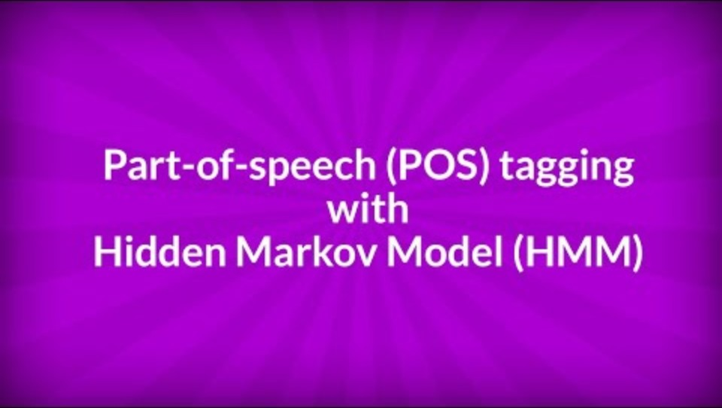


Slide 9
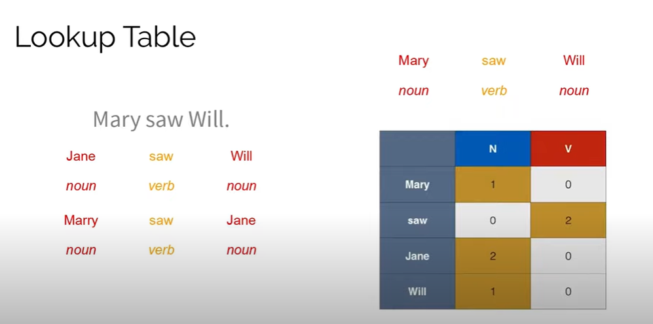

Slide 10
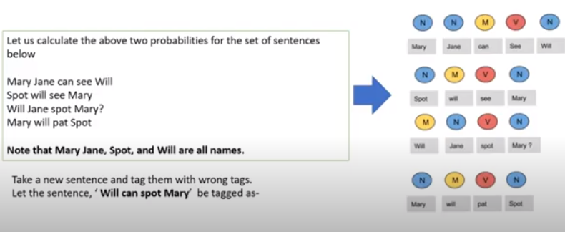

Slide 11
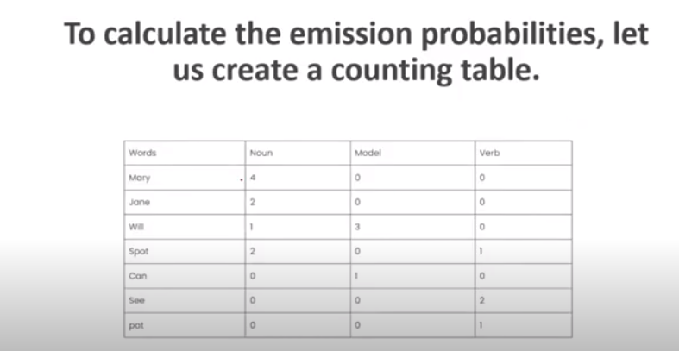

Slide 12
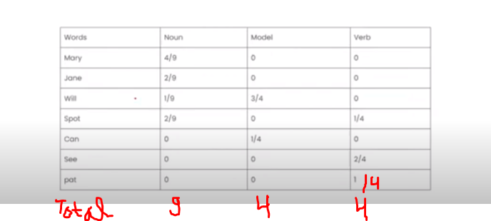
Emission probability

Slide 13
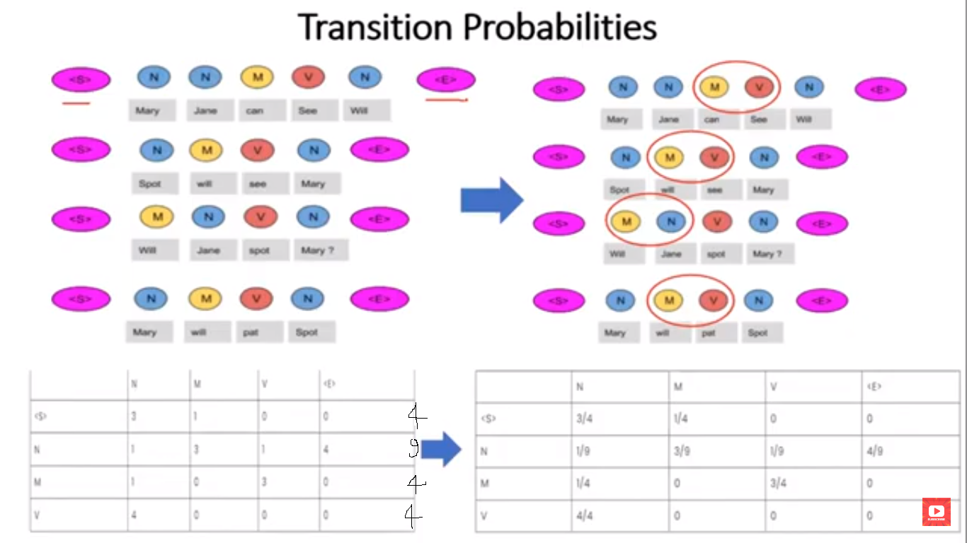

Slide 14

Transmission probability

Slide 15
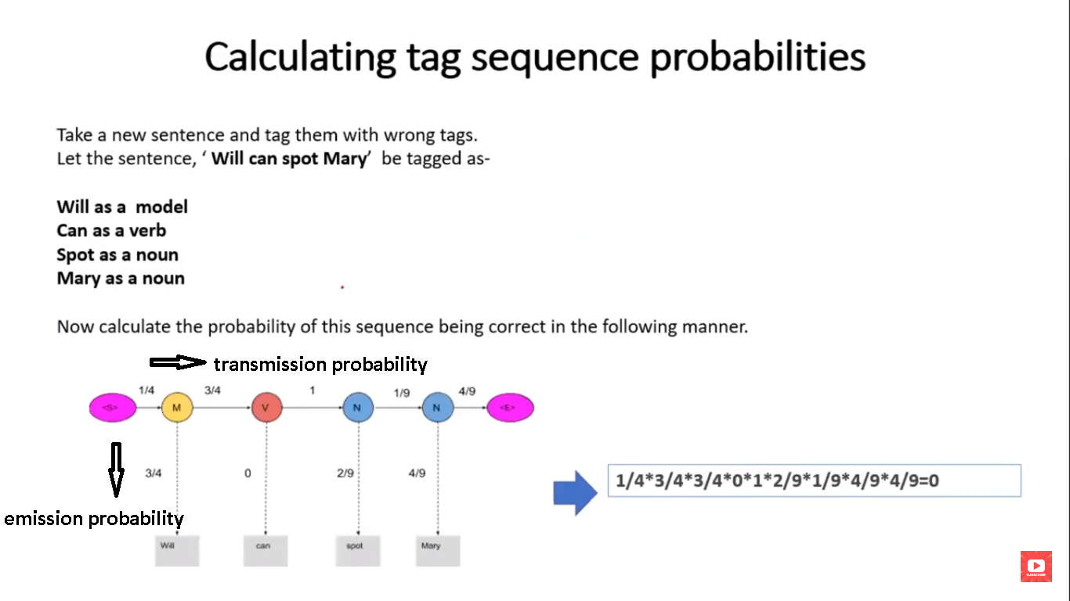

Slide 16
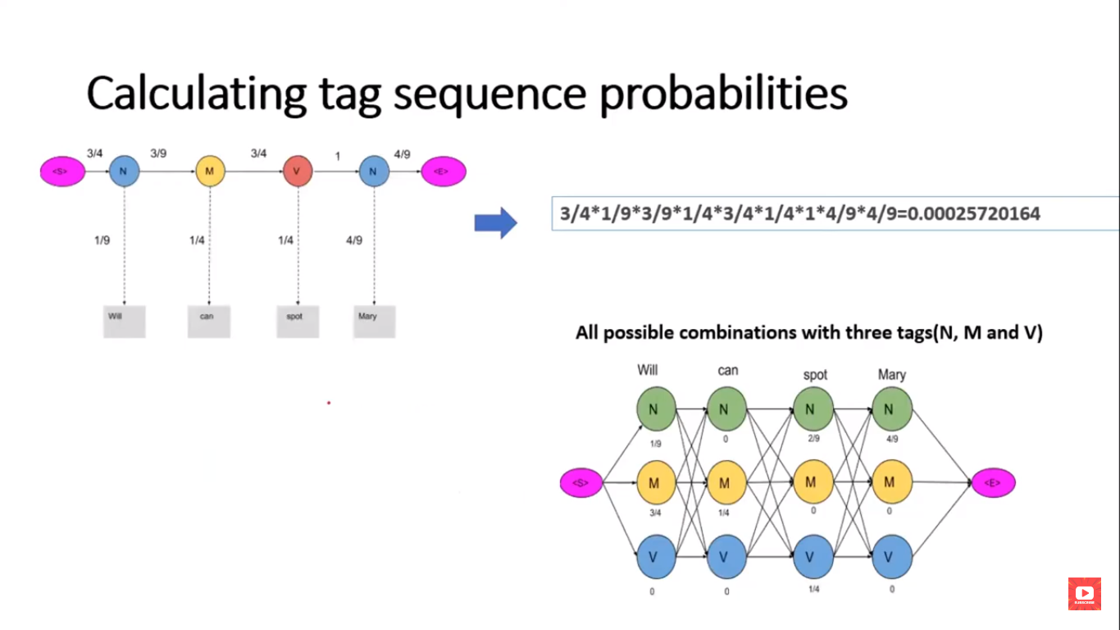

Slide 17
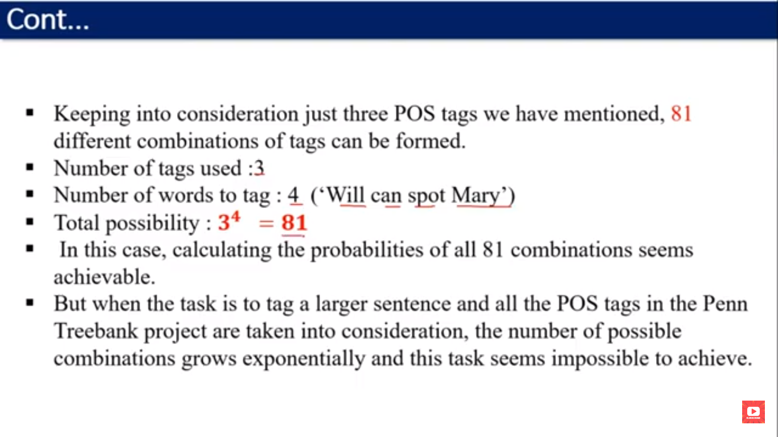

Slide 18
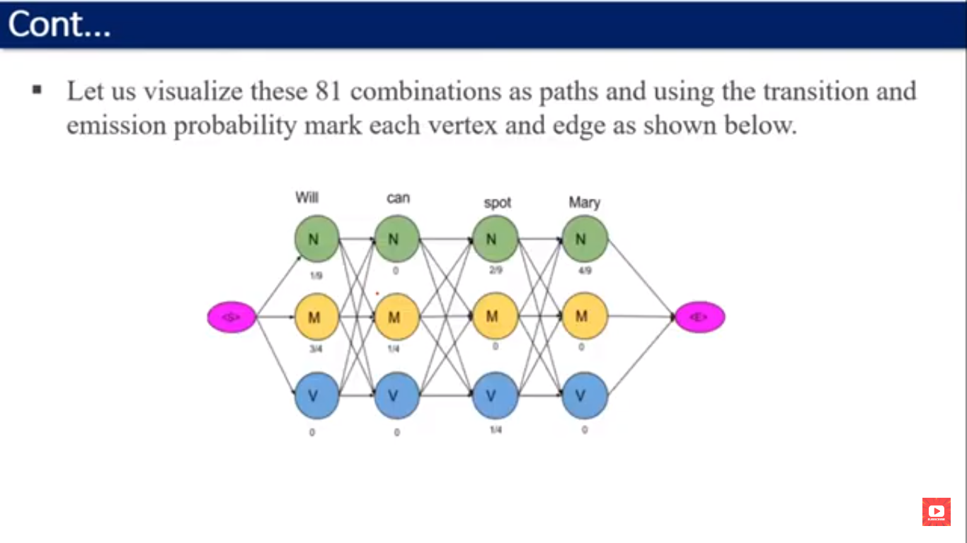

Slide 19
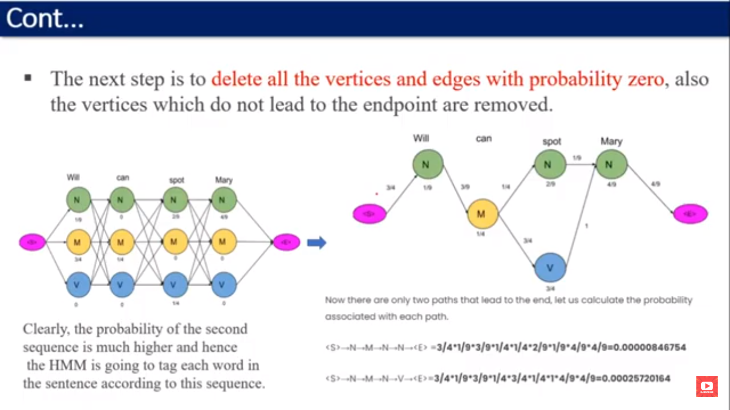

Slide 20
Activity 1(Think pair share)Pen and paper
How does the HMM handle ambiguity (e.g., “book” as noun vs verb)?
Answer:

Slide 21


Activity 2 (problem based learning) wooclap activity
Q1. Assume:
P(Verb ∣ Modal)=0.8
P(Noun∣Modal)=0.2
P(book∣ Verb)=0.6
P(book∣Noun)=0.4
Compute score for predict book as verb or noun

Slide 22
Reflection

Slide 23
At the end of this session students will be able to know
Apply HMM for TAG Prediction in new sentence
Explain Transmission and emission probability

Slide 24


Information about the next lesson: Viterbi algorithm

Slide 25
Discussion on the post session activities Q1. I read a book. I will book a ticket. Predict tags for statement “ I will book a flight” using HMM. Q2. Why is context important in POS tagging?

Slide 26
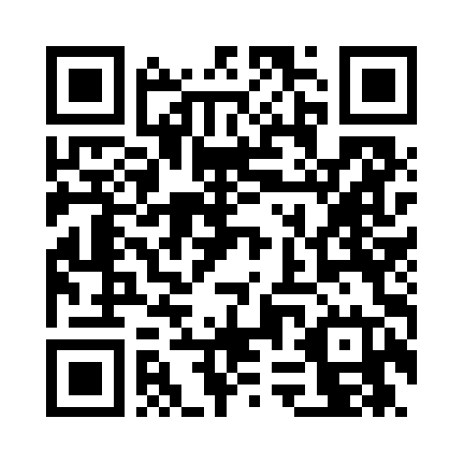
Review and Reflection from students
Participation link

